Slide 1

Intelligent Object Sorting using Deep Reinforcement Learning Robot & Computer Vision
Robotics Lab, Winter Term 2021-22
Kanishk Navale / 3437531 Olga Klimashevska / 3525388

Slide 2
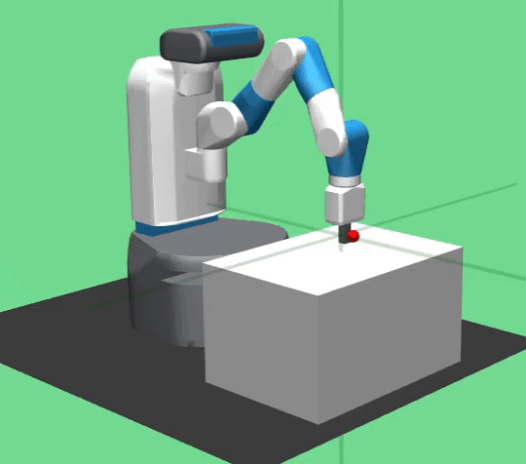
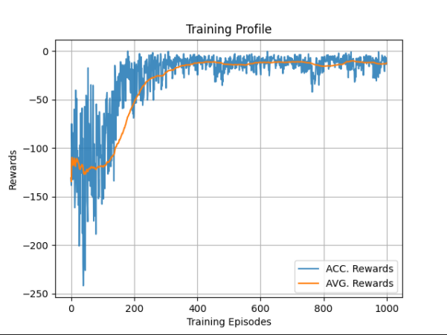
Proof of Concept
Benchmarking DDPG, TD3 & PPO on openai-gym ‘'FetchReach-v1'’
Training Profile of the DDPG Agent

Slide 3
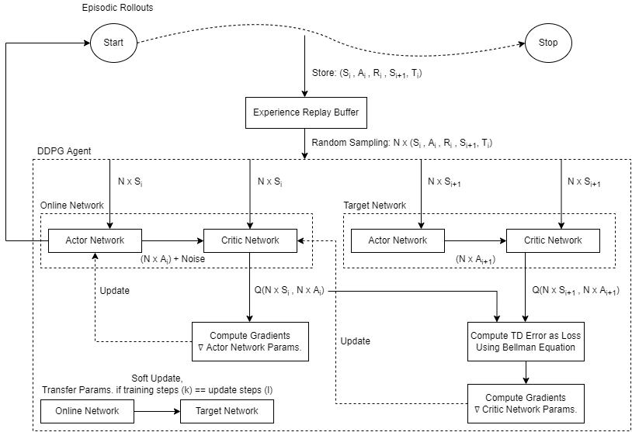
Vanilla DDPG Algorithm

Slide 4
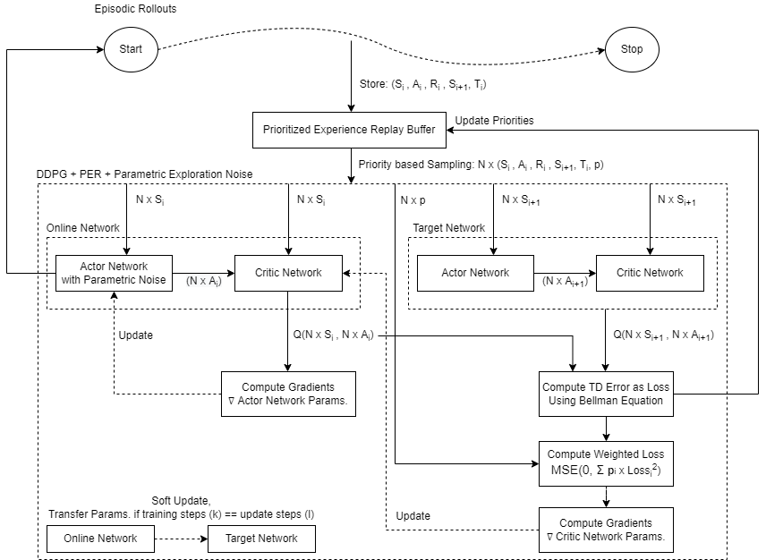
Engineering a better DDPG Algorithm

Slide 5
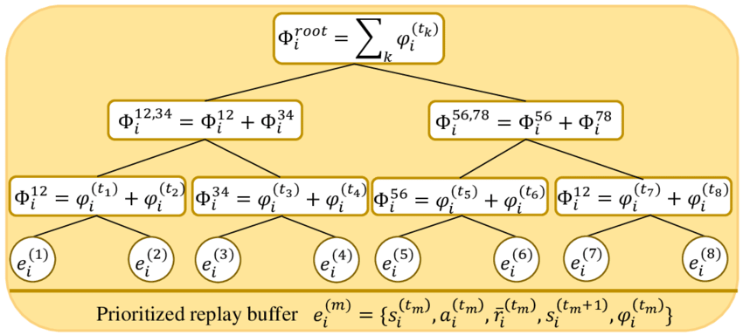
Prioritized Experience Replay Buffer
Random Sampling of experiences is not used.
Instead, newest experiences are sampled first.
Then, sample experiences priorities wise based on TD errors.
It enables the agent to relearn the experiences to get better rewards.

Slide 6
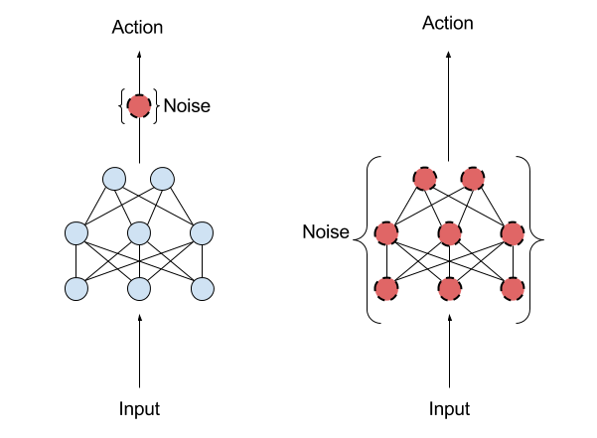
Parametric Exploration Noise
Added Gaussian Noise is not used for exploration (left image).
Instead, a new clone network of actor is created with noisy weights.
This ‘Noisy Actor’ produces noisy action for exploration.

Slide 7
Building State & Action for Interaction
For each play step in a game,
Build: state = Current Robot TCP(x, y, z) | Target Location P(x, y, z)
Compute: action = actor.choose_noisy_action(state)
Get: next_state, reward, done = env.step(action)
Reward = -1.0 * Euclidean Distance (Current Robot TCP, Target Location P)
DDPG Agent is optimized to maximize the reward for each play step over the games.

Slide 8
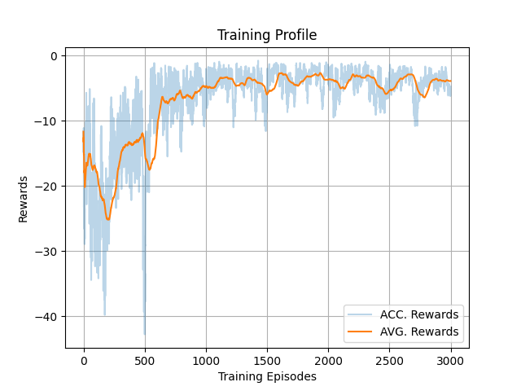
Comparison of Vanilla DDPG & Our DDPG
Result: The DDPG Agent is 5 times better (metric: training rewards) with PER & Parametric Exploration Noise.

Slide 9
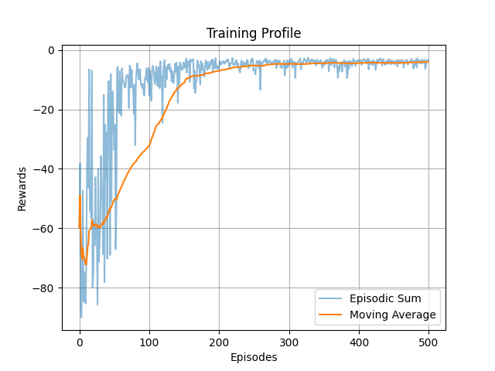
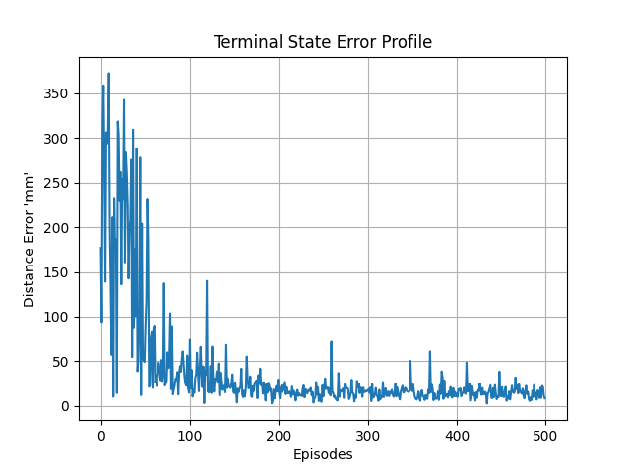
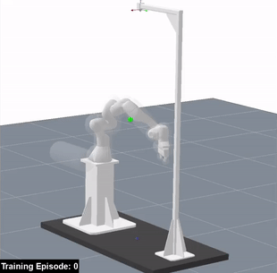
Training DDPG Agent for Robot Motion
SolidWorks is used to develop the meshes.
Meshes are exported & imported in ‘rai’ after processing .urdf files.
The ‘gym’ wrapper is used to create ‘reach_gym’ to train the robot.
It takes 1Hr. to train the robot for 500 episodes.
The robot reaches any point in the Cartesian space with error of ±5mm.
The training occupies 3GB of GPU.

Slide 10
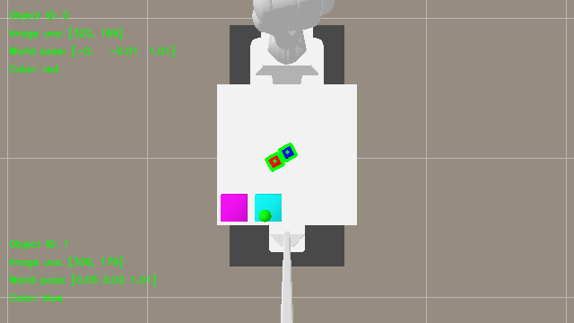
Pose Estimation Pipeline
Pose estimation is done for ‘red’ & ‘blue’ objects.
Depth & RGB image is used to compute the use.

Slide 11
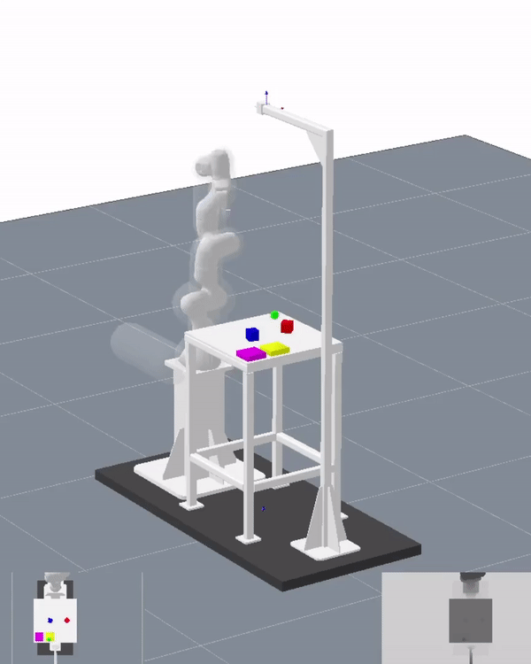
Object Tending

Slide 12
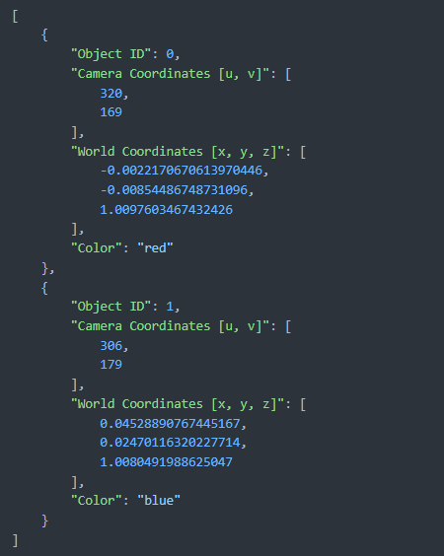
Process Logging
We store the image from the Pose Estimation Pipeline as .png image.
Also, the detailed object data in a ‘.json’ file for debugging purposes.

